Slide 1
MULTI-CUT-OFF REBAR
Advisor : Prof. K.C.Chang
Presenters : You-Ran Nai
Notes:
Try 講清楚脈絡

Slide 2
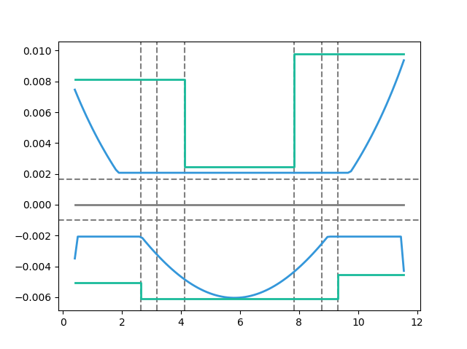
Max
Max
Design As
Today’s Solution
Fixed Bar-Cut
Max
Demand As
Notes:
LowSeismic4Floor12M 0
加上座標

Slide 3
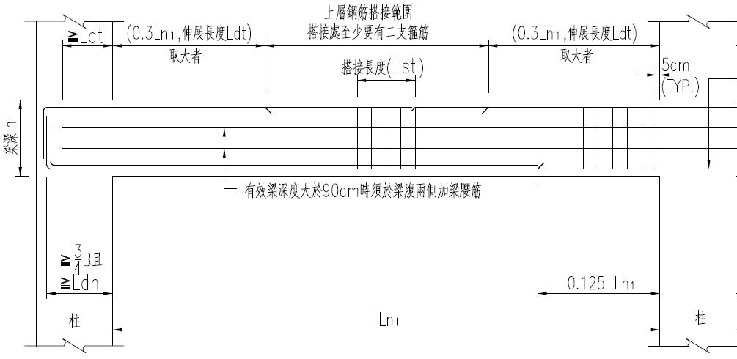
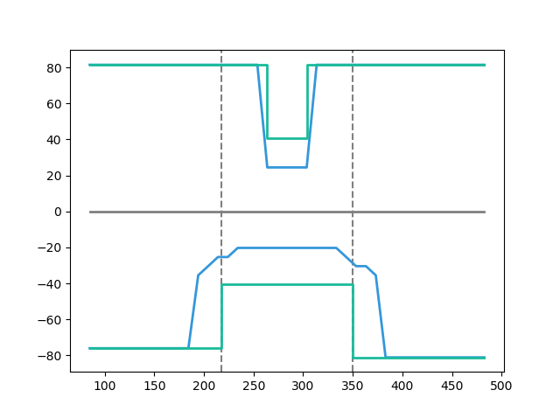
大梁鋼筋配置標準圖
Tradition
Design As
Demand As
Notes:
欣銓 1140
加上座標

Slide 4
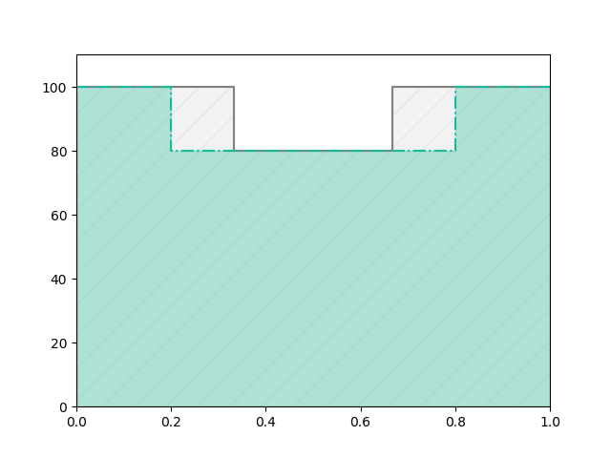
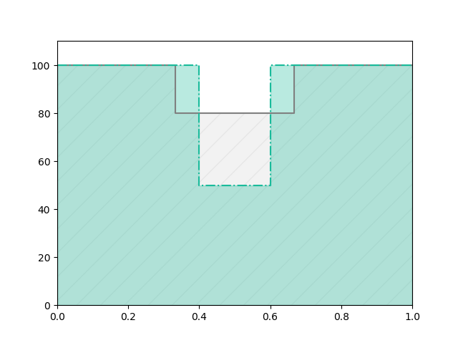
Before
After
REDUCE REBAR
Before
Real
Demand
After
Notes:
# 問題與目標
目前工程上斷筋處都固定在 1/3 或是 1/5 處
之所以這樣是為了施工上比較方便
但是這樣會有不經濟的問題產生
如果我們能做到根據需求來決定斷筋處
就能節省鋼筋的用量

Slide 5
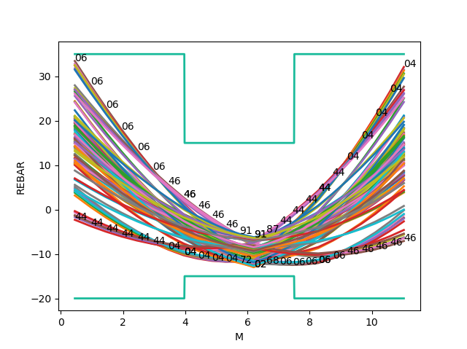
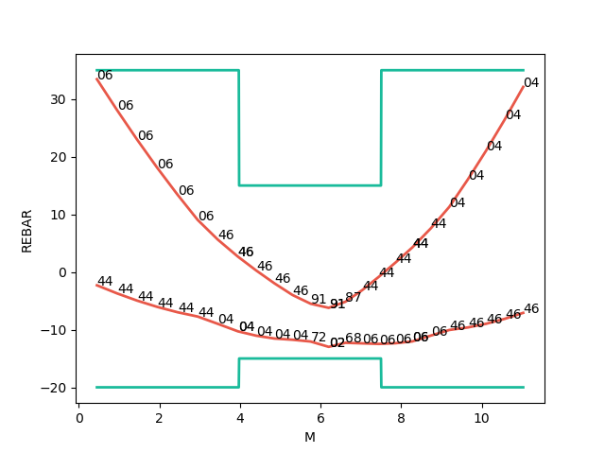
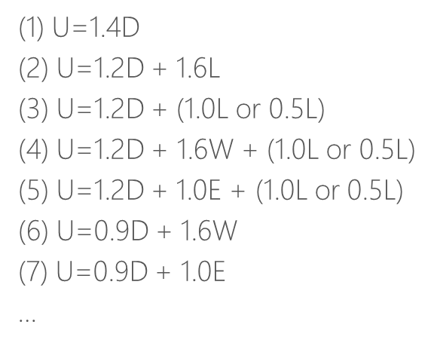
Mu
Consider Hundreds Of Combo Demand
Catch Critical Demand Combo

Slide 6
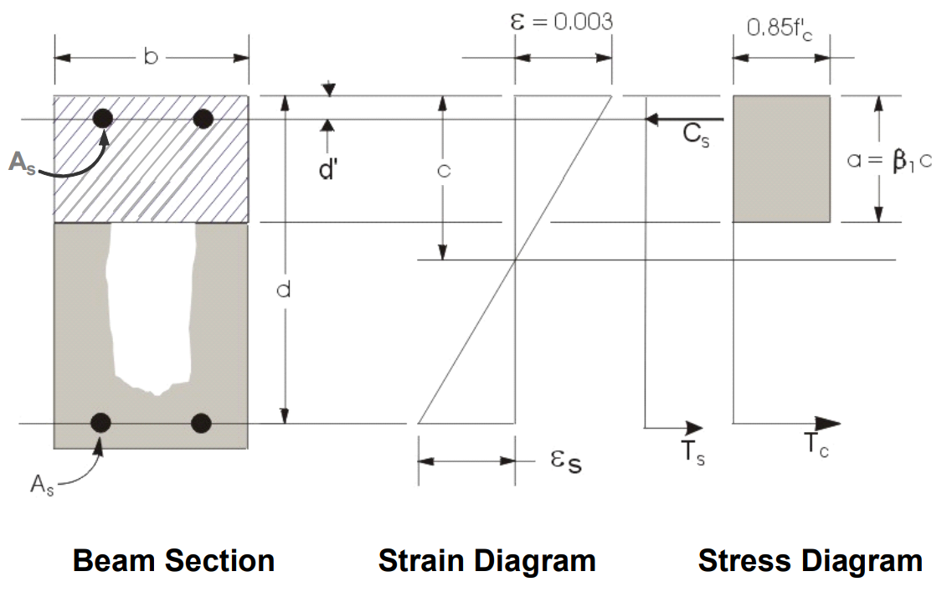
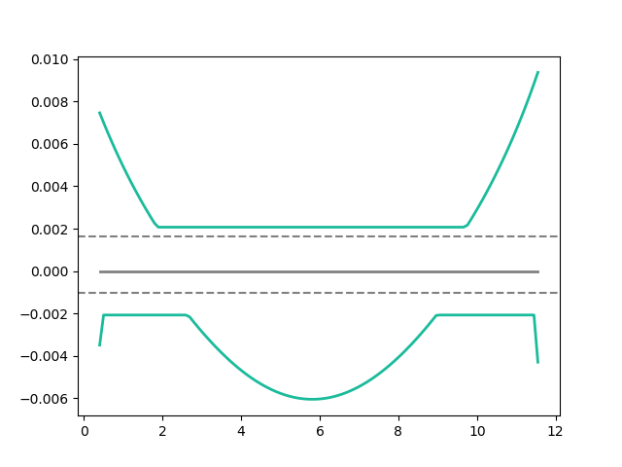
Flexural Reinforcement
Area of flexural reinforcement
Min: 2 Rebar

Slide 7
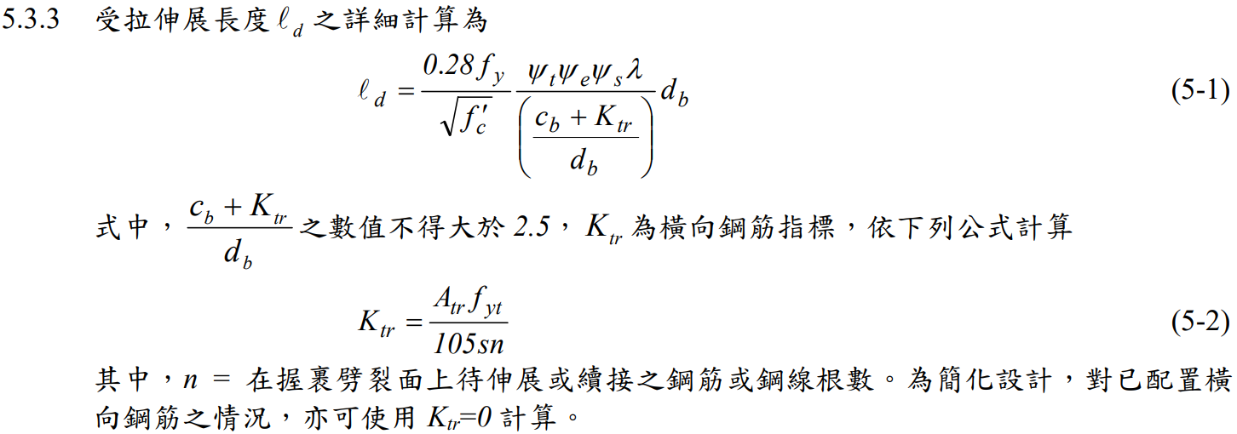
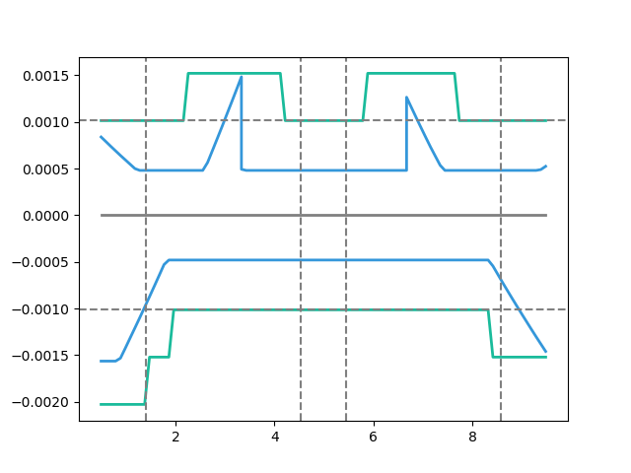
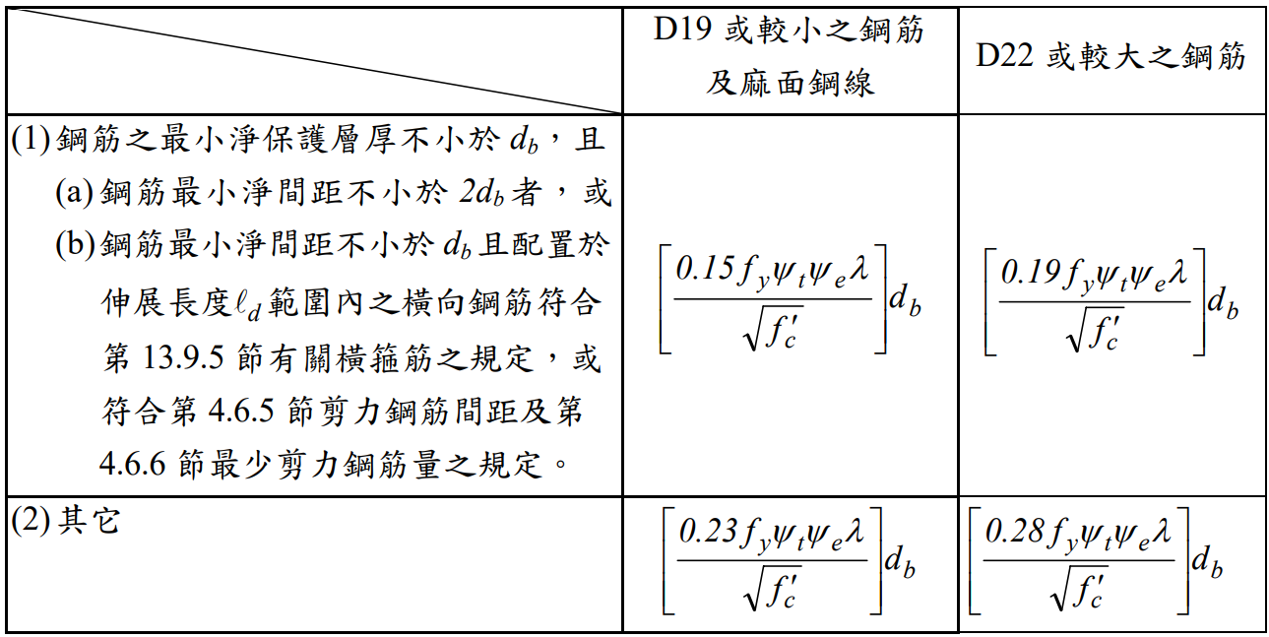
General Development Length Equation
Development Length
MIN
Demand As
Simplified Provisions
Development Length

Slide 8
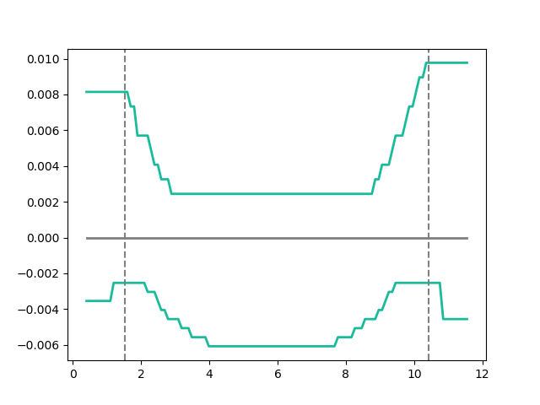
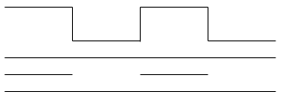
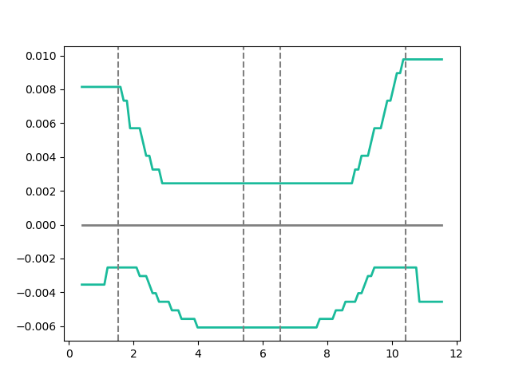
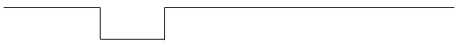
Combinations
As
多點
0.1
0.9
漸進式退縮
三段
0.1
0.45
0.55
0.9
Notes:
GA 演算法

Slide 9
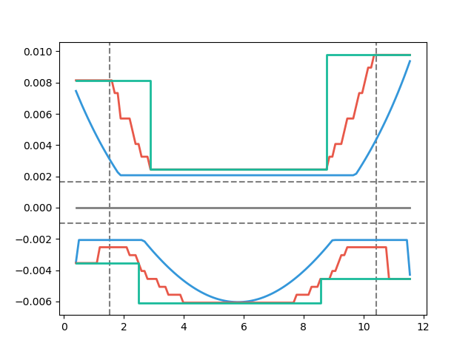
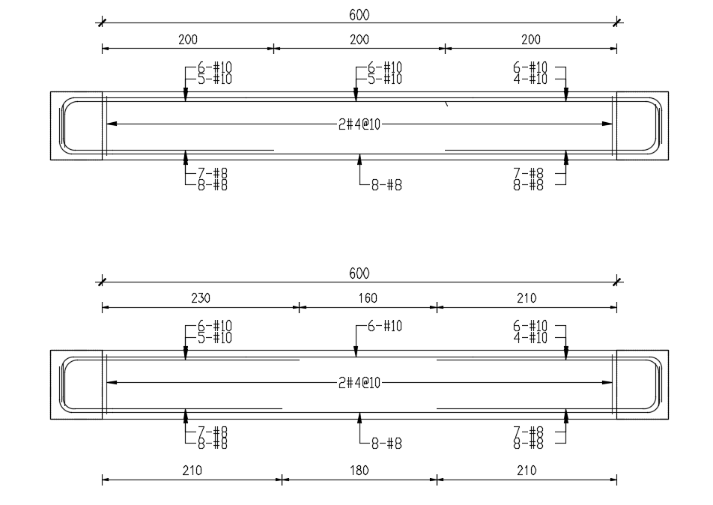
Development Length
梁撓曲鋼筋配置示意圖
Design As
Demand As

Slide 10
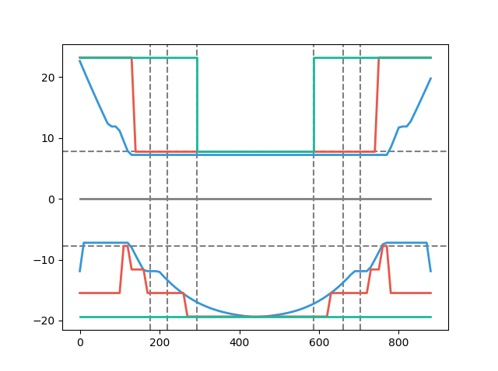
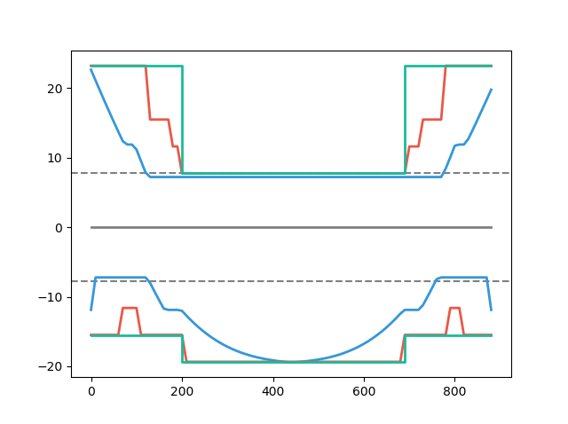
Simple Conclusion
Tradition
Simplified Ld
Multi-Cut
Design As
Design As
Explicit Ld
100%
80%
Demand As
Demand As
100%
91%
Notes:
11076

Slide 11
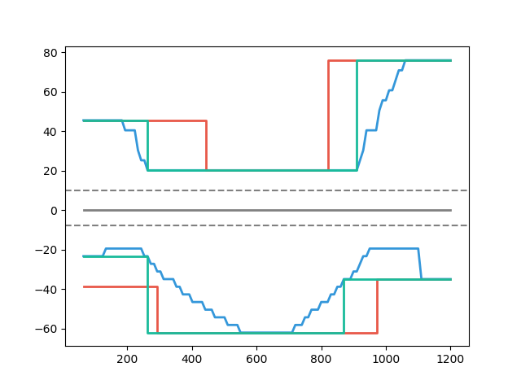
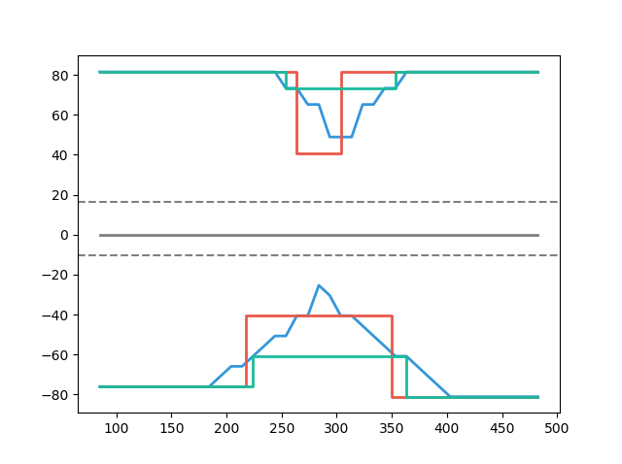
Case Study
Multi-Cut 82%
Tradition
Multi-Cut
Tradition
Development Length
Development Length
Multi-Cut 91%
Multi-Cut
Notes:
傳統不經濟
828
傳統不保守 不符合 混凝土結構設計規範 401-100 R5.11.2
1140

Slide 12


Slide 13
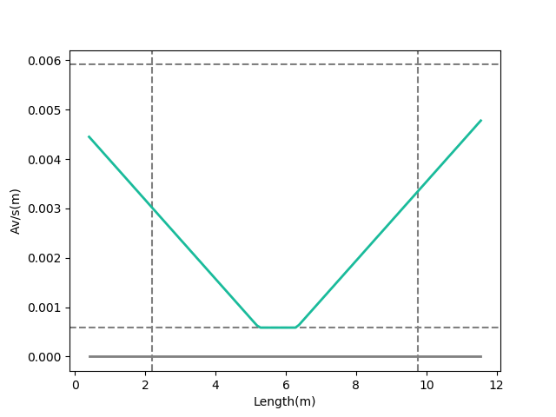
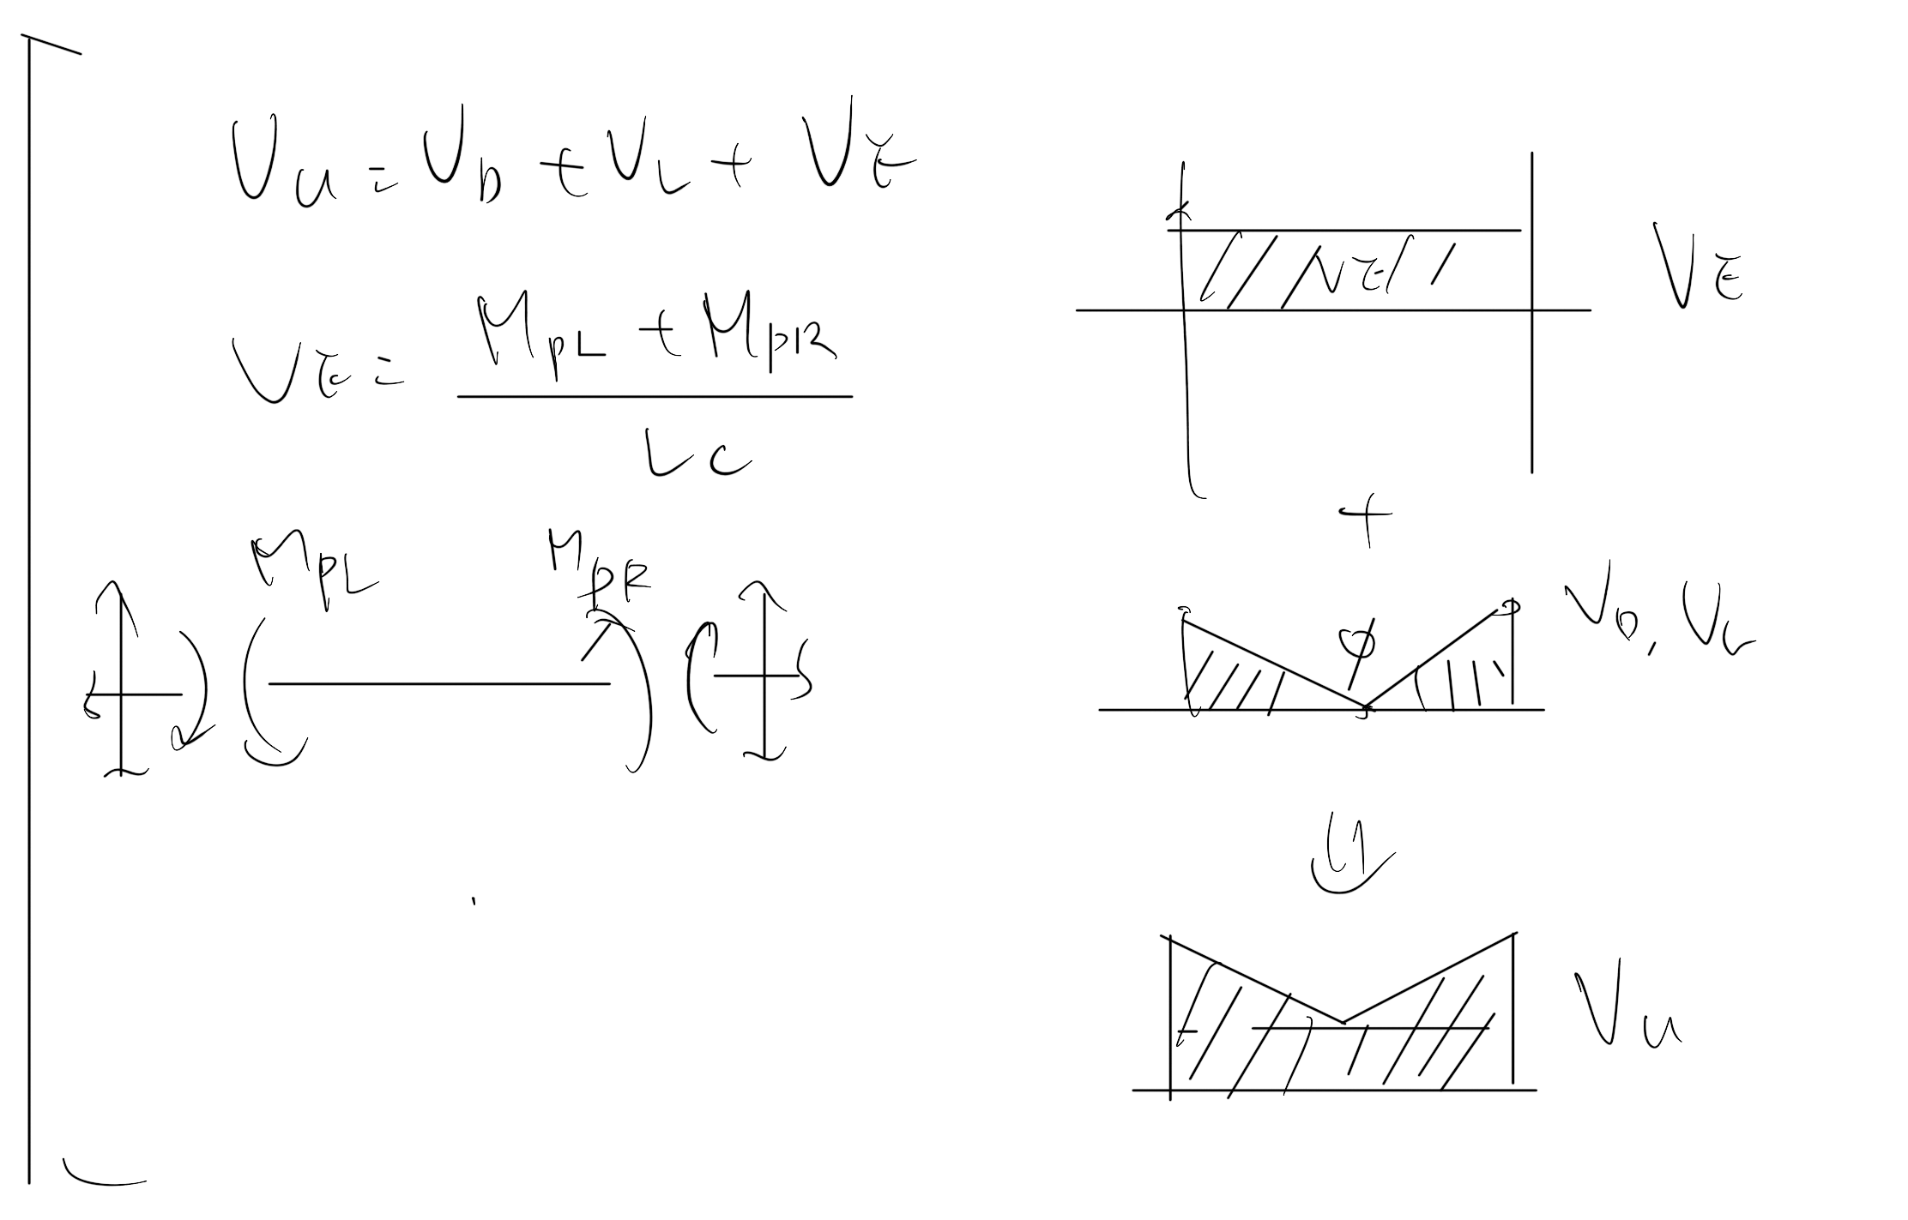
Vu
Vu
Notes:
LowSeismic4Floor12M 0

Slide 14
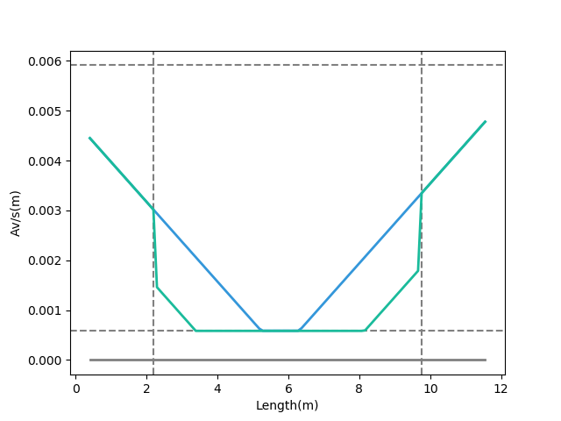
Shear Reinforcement
Vu
Notes:
LowSeismic4Floor12M 0

Slide 15
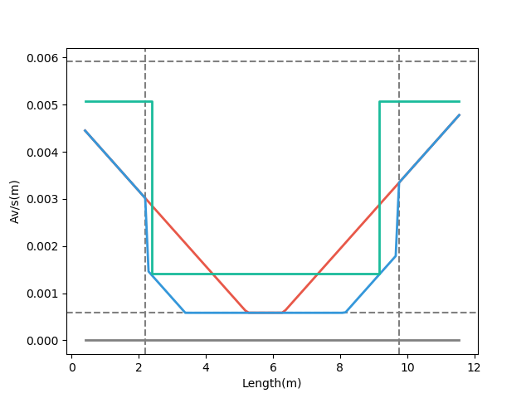
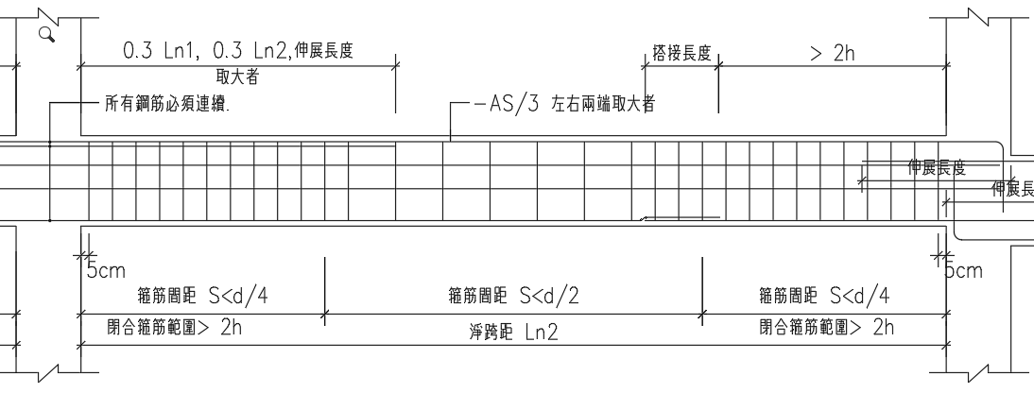
Notes:
LowSeismic4Floor12M 0

Slide 16
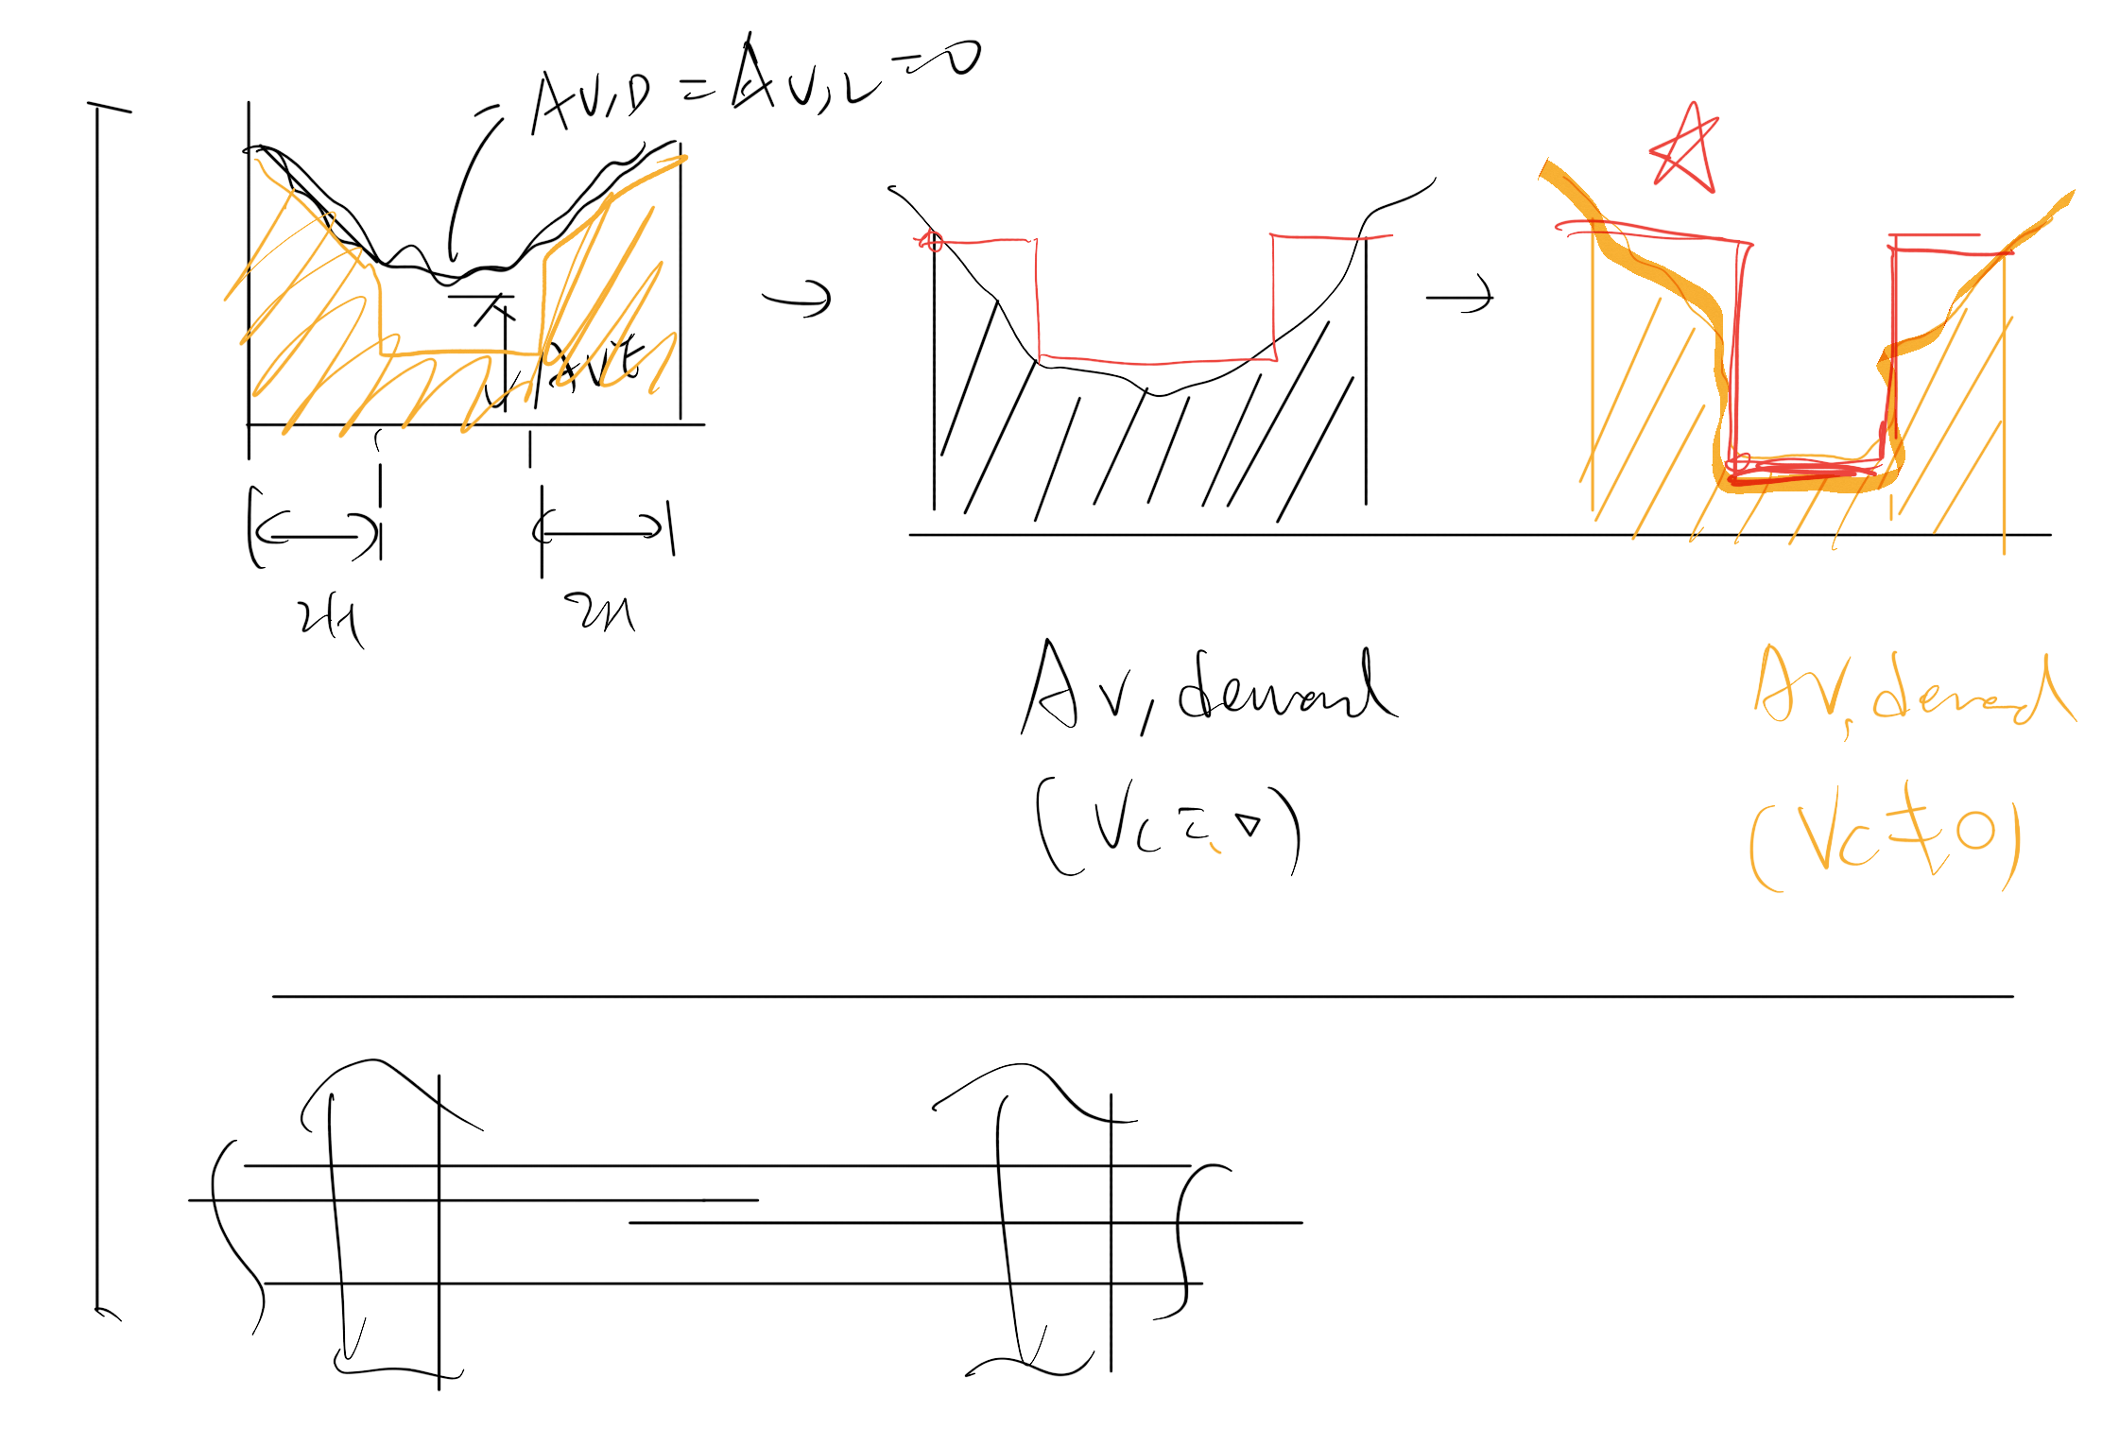

Slide 17
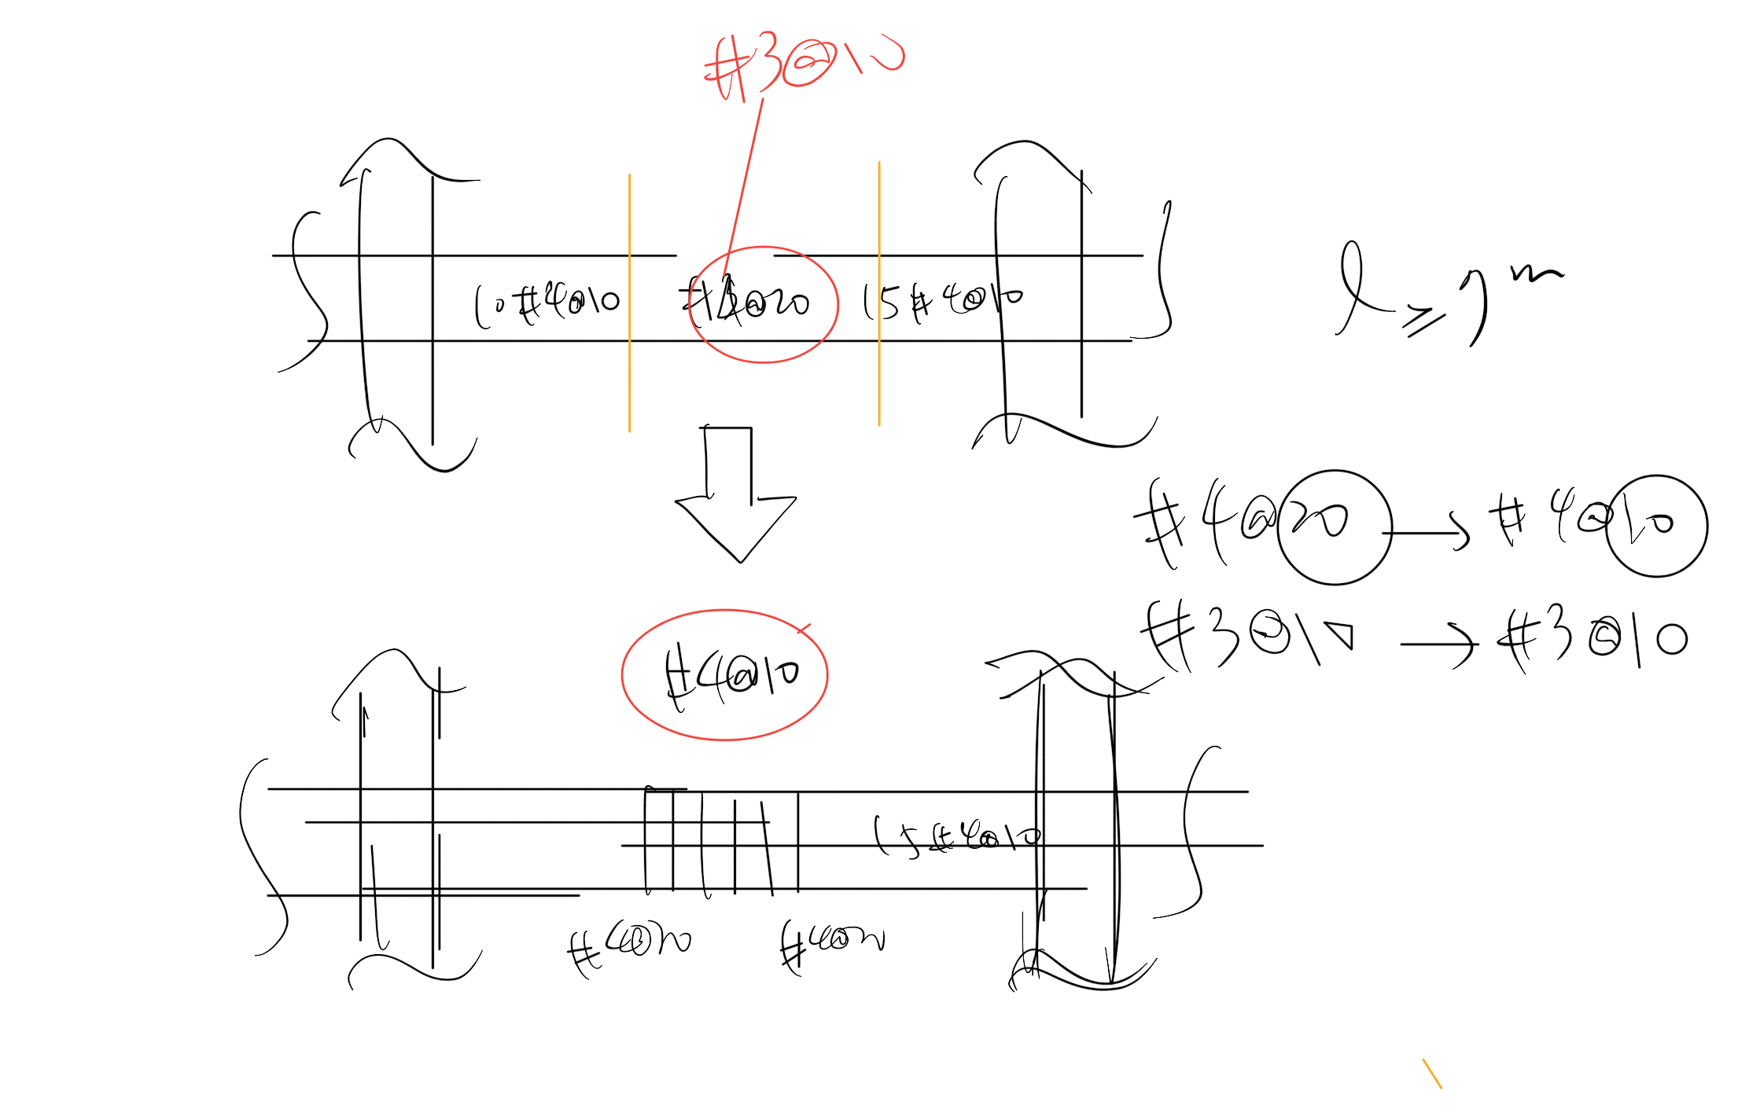

Slide 18
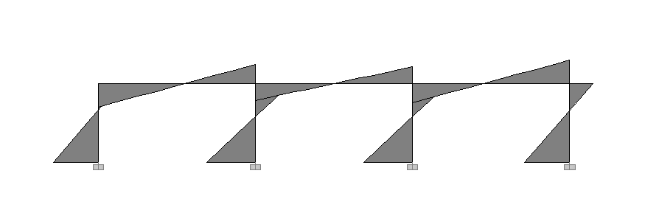
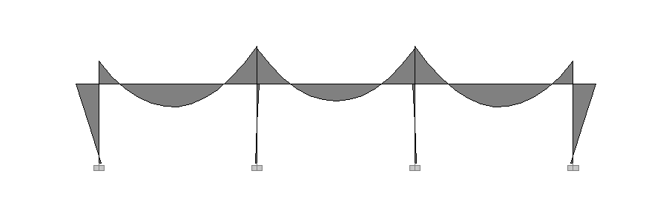
Seismic Load
Moment Diagram
Gravity Load

Slide 19
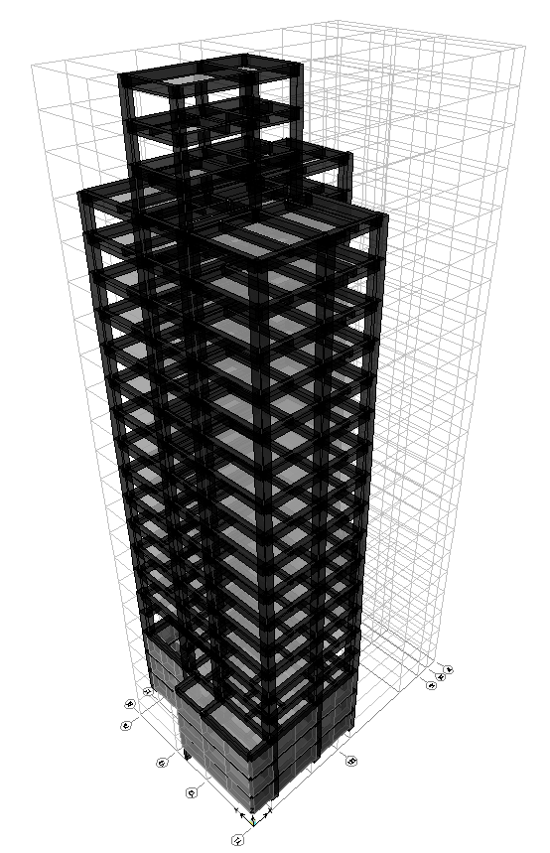
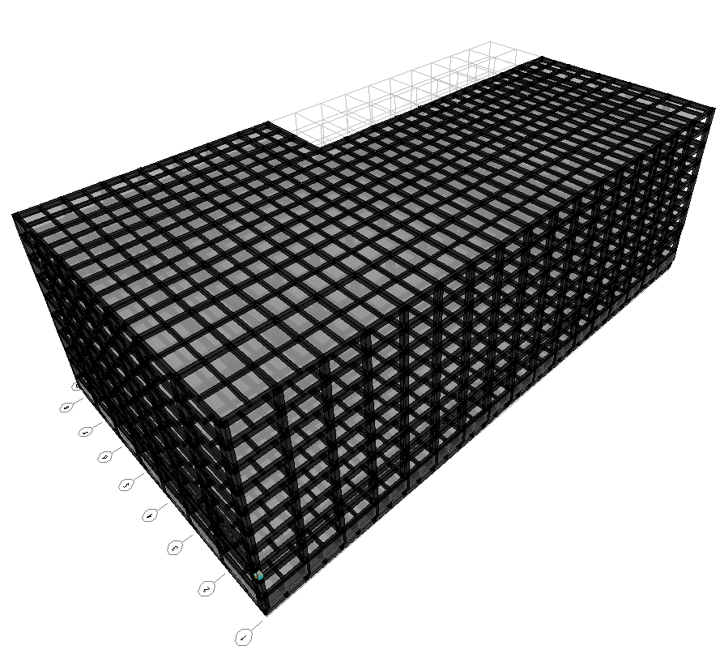
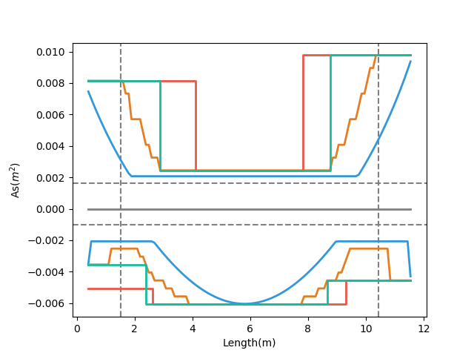
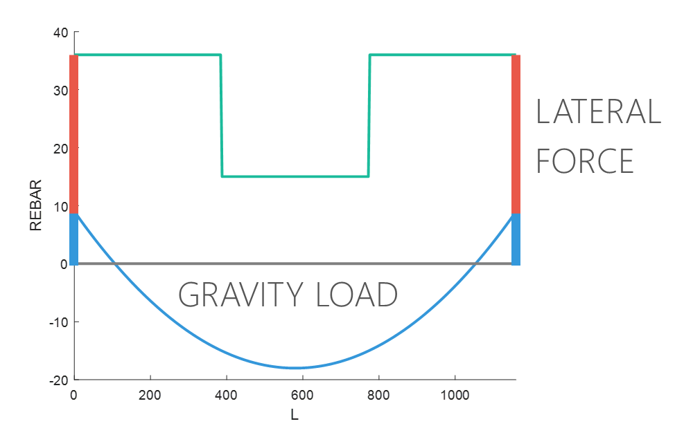
Moment Decay
&
Short Ld
$$\frac{Seismic Load}{Gravity Load}=Small$$
Beam Length
Notes:
下層筋都有可能
梁長影響 Moment Decay & Ld
LowSeismic4Floor12M 0

Slide 20
11 Models
+
Notes:
LowSeismic4Floor12M 0

Slide 21
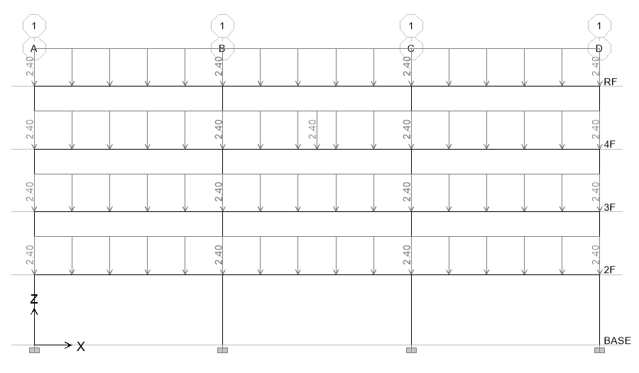
Model Assume
Notes:
混凝土強度越高效果越好
重力需考慮樓版

Slide 22
Evaluation
$$\frac{Seismic Load}{Gravity Load}=Small \& Long Span$$
$$\frac{Seismic Load}{Gravity Load}=Large \& Short Span$$
Notes:
大部分是直通筋，不太準

Slide 23
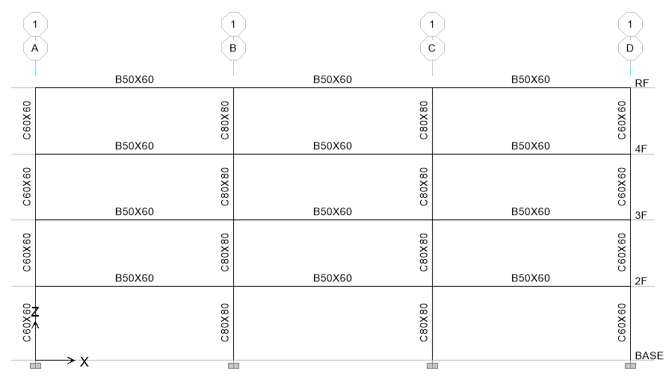
Evaluation
3
47.9s
12 支梁
4
3.9min
5
23.1min
6
2.0hr

Slide 24
台北住宅案
101.0%
OVERALL RESULT
14F B3
102.5%
TOP RESULT
99.2%
BOT RESULT
20m
30m
Notes:
由於很複雜，先記得最終的結果
400

Slide 25
9F B1
93.5%
OVERALL RESULT
92.4%
TOP RESULT
153m
77m
94.7%
BOT RESULT
高雄物流中心
Notes:
3500

Slide 26
COST ANALYSIS
REDUCED PERCENTAGE
MATERIAL REDUCED COST
$$Δ=−\frac{60kg}{m^{2}}∗2\%∗\frac{\$28}{kg}=−\$33.6/m^{2}$$
GIRDER USED
MATERIAL COST

Slide 27
COST ANALYSIS
INCREASE
CONSTRUCTION COST
REDUCED
MATERIAL COST
$$Δ=\frac{\$100}{t}∗\frac{0.15t}{m^{2}}−\frac{60kg}{m^{2}}∗2\%∗\frac{\$28}{kg}=−\$18.6/m^{2}$$
$$Δ=\frac{\$200}{t}∗\frac{0.15t}{m^{2}}−\frac{60kg}{m^{2}}∗2\%∗\frac{\$28}{kg}=−\$3.6/m^{2}$$
INCREASE WAGE

Slide 28
COST ANALYSIS
$$Δ=−\frac{60kg}{m^{2}}∗2\%∗\frac{\$28}{kg}=−\$33.6/m^{2}$$
$$Δ=\frac{\$100}{t}∗\frac{0.15t}{m^{2}}−\frac{60kg}{m^{2}}∗2\%∗\frac{\$28}{kg}=−\$18.6/m^{2}$$
$$Δ=\frac{\$200}{t}∗\frac{0.15t}{m^{2}}−\frac{60kg}{m^{2}}∗2\%∗\frac{\$28}{kg}=−\$3.6/m^{2}$$
$$Δ=\frac{\$200}{t}∗\frac{0.15t}{m^{2}}−\frac{60kg}{m^{2}}∗5\%∗\frac{\$28}{kg}=−\$54/m^{2}$$

Slide 29
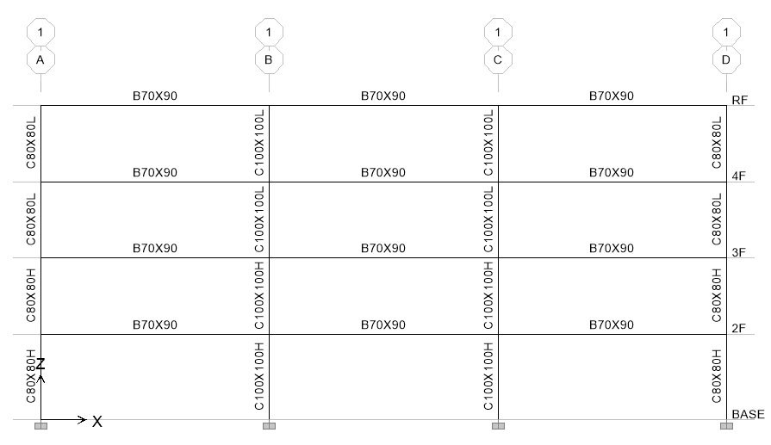
Case Study

Slide 30
Design Earthquake

Slide 31
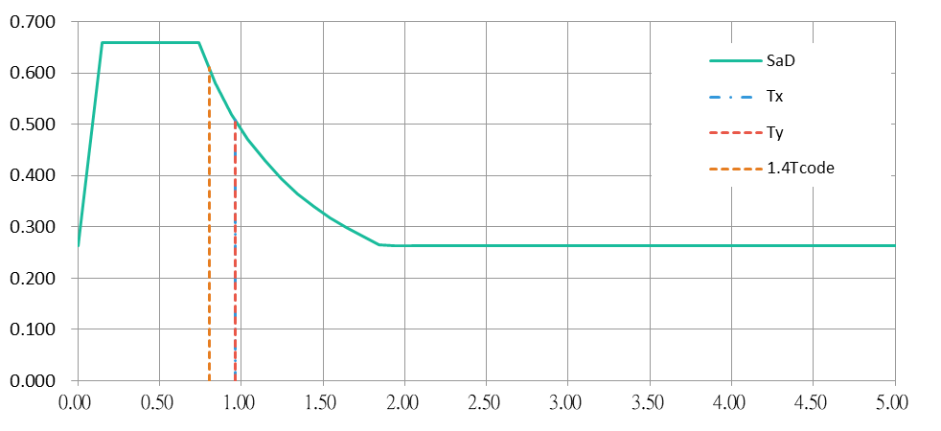
Design Earthquake

Slide 32
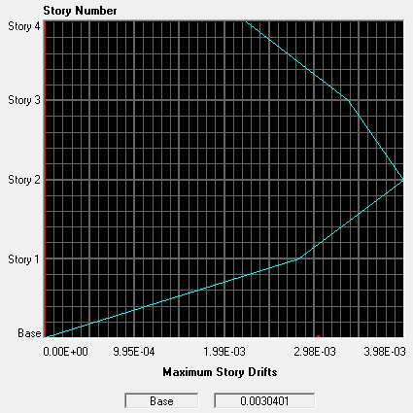
Story Drift
0.32%

Slide 33
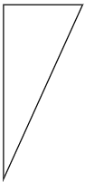
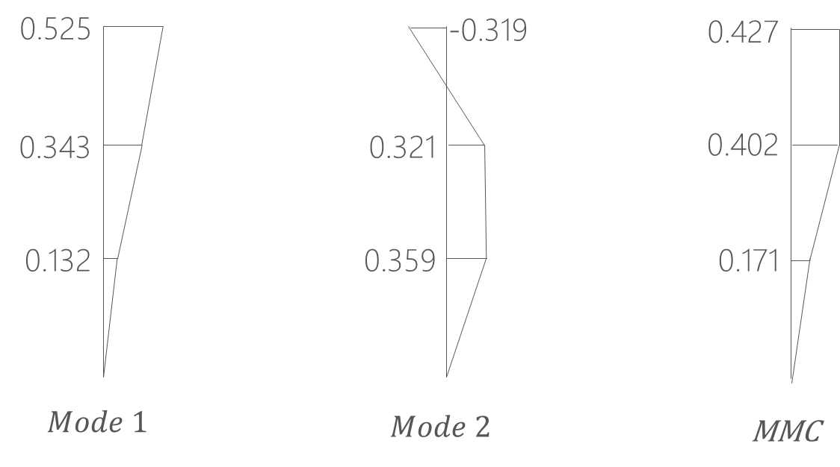
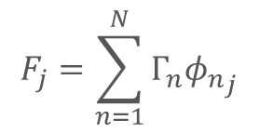
Pushover Load Pattern
Inverted Triangle
Multi-Modes Combination
Modal Pushover Analysis
$$F_{j}=\sum_{n=1}^{N}{Γ_{n}{φ_{n}}_{j}}$$
SRSS
Notes:
定義非線性驗證的邊界

Slide 34
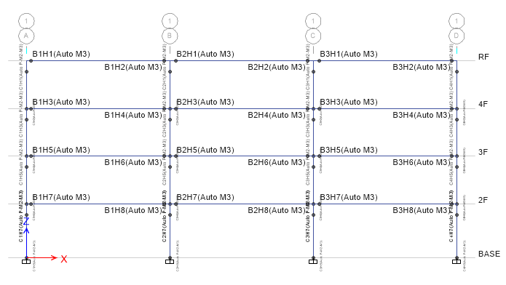
Hinges Only On Two Ends

Slide 35
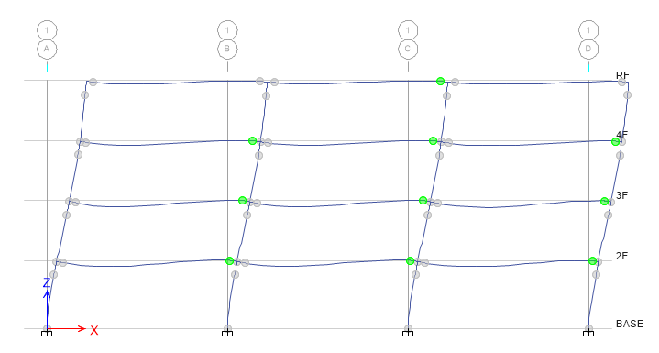
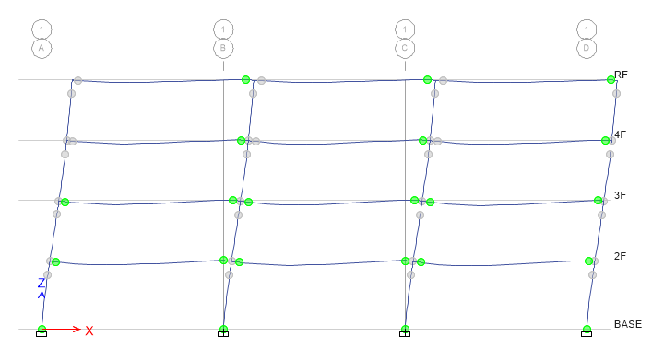
Step 3
Step 9

Slide 36
Modal Pushover Analysis

Slide 37
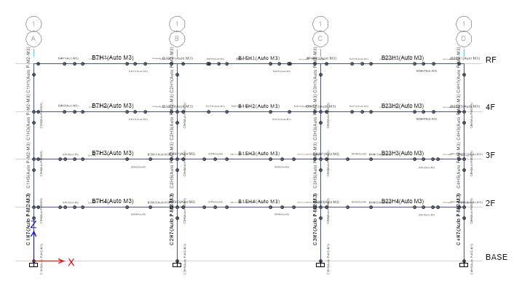
Multiple Hinges

Slide 38
Modal Pushover Analysis

Slide 39
Multi-Modes Combination

Slide 40
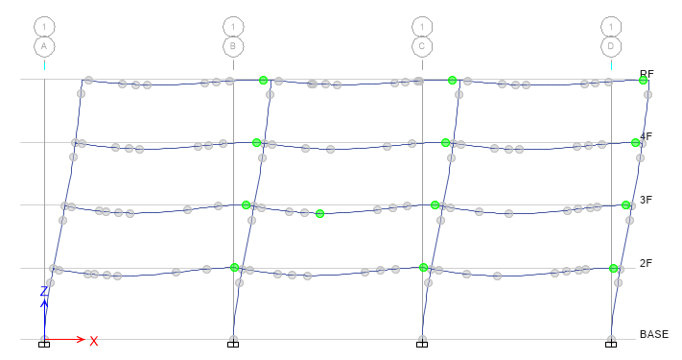
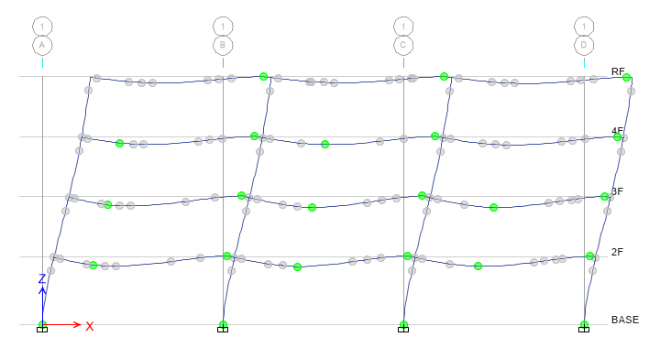


Step 3
Step 5
Step 7
Step 8

Slide 41



Pushover Result
Hinge
Notes:
比較 Ra, R 值
DBE, MCE 的性能績效點對應到 delta_u
雙線性化找到 delta_y,eff

Slide 42


Pushover Result
耐震性能檢測 PGA
ATC-40

Slide 43

Time history
Story Drift
Scaled to DBE, MCE
DBE < 1.5%
MCE < 2%

Slide 44
Scaled

Slide 45


DBE
MCE

Slide 46


Hinges Only On Two Ends

Slide 47


Multiple Hinges

Slide 48


IDA
Limit-State
4% FEMA273
2.5% SEAOC 2000

Slide 49


INTRODUCTION
SINGLE STATIC ANALYSIS
➔
INCREMENTAL SPO
SINGLE TIME-HISTORY ANALYSIS
➔
INCREMENTAL ONE

Slide 50

NON-LINEAR SPO
ELASTIC
➔
MATCH
NON-NEGATIVE
➔
EQUAL DISPLACEMENT
NEGATIVE
➔
SOFTENING

Slide 51


Hinges Only On Ends

Slide 52

Multiple Hinges

Slide 53
Hinges Only On Ends
Multiple Hinges
0.014
0.017

Slide 54


Normal Side

Slide 55


Normal NoLd

Slide 56

Normal Ld

Slide 57

Nonlinear Hinge
Notes:
手做一次模型
開發程式 for etabs 2016
塑絞設定
TEASPA
SERCB
遲滯迴圈

Slide 58
Hinge
Third Hinge
+

Slide 59


Hinge
Without Initial Conditions

Slide 60
Pushover Load Pattern
Triangle
Multi-Modes Combination
Modal Pushover Analysis
$$F_{j}=\sum_{n=1}^{N}{Γ_{n}{φ_{n}}_{j}}$$
SRSS
Notes:
定義非線性驗證的邊界

Slide 61
Pushover Result
Hinge
Notes:
比較 Ra, R 值
DBE, MCE 的性能績效點對應到 delta_u
雙線性化找到 delta_y,eff

Slide 62
Pushover Result
耐震性能檢測 PGA
ATC-40

Slide 63
Time history
Story Drift
Scaled to DBE, MCE
DBE < 2%
MCE < 3%

Slide 64
IDA
Limit-State
4% FEMA273
2.5% SEAOC 2000

Slide 65







Slide 66


1D CUT

Slide 67




INPUT
2 MILLIONS
10 MILLIONS
30 THOUSANDS
GEOMETRY
MATERIAL
SECTION
BEAM FORCE
0.5 => 0.1
E2K
DESIGN REBAR
- ACI 318-05

Slide 68
GRAPH
REBAR SIZE & NUM
REBAR LENGTH
STIRRUP SIZE & S
B & D & L
SUPPORT WIDTH
STIRRUP_REBAR = ['#4', '2#4', '2#5', '2#6']
STIRRUP_SPACING = [10, 12, 15, 18, 20, 25, 30]
first calc SIZE & S
groupby a beam
while spacing < MIN_SPACING
UPGRADE SIZE
MERGE
x <= $1/4$
$1/4$ <= x <= $3/4$
x => $3/4$
DROP DOUBLE SIZE

Slide 69

GRAPH
REBAR SIZE & NUM
REBAR LENGTH
STIRRUP SIZE & S
B & D & L
SUPPORT WIDTH
FIRST RUN
first calc SIZE & NUM
TOP_BAR = ['#7', '#8', '#10']
DB_SPACING = 1.5
groupby a beam
while num > 2 * capacity
UPGRADE SIZE
CONSERVATIVE MERGE
x <= $1/3$
$1/4$ <= x <= $3/4$
x => $3/4$
Calc Ld
OPTIMIZATION ALGORITHM

Slide 70

一台梁
SAME SIZE

Slide 71
GRAPH
REBAR SIZE & NUM
REBAR LENGTH
STIRRUP SIZE & S
B & D & L
SUPPORT WIDTH
FIRST RUN
SECOND RUN
first calc SIZE & NUM
groupby 一台梁
while any size < max size
calc max SIZE & NUM
groupby a beam
while num > 2 * capacity
UPGRADE SIZE
Calc Ld
CONSERVATIVE MERGE
x <= $1/3$
$1/4$ <= x <= $3/4$
x => $3/4$
OPTIMIZATION ALGORITHM
Calc Ld
OPTIMIZATION ALGORITHM

Slide 72

GRAPH
REBAR SIZE & NUM
REBAR LENGTH
STIRRUP SIZE & S
B & D & L
SUPPORT WIDTH
POINT COORDINATES
$(x_{2}−x_{1}, y_{2}−y_{1})$
CONCRETE SECTIONS
MIN
梁長 - MAX

Slide 73

THE OTHER CASE
NORMAL GRAVITY LOAD
TOO CONSERVATIVE
MORE THAN INITIAL REBAR
➔
➔
➔
➔

Slide 74
THE OTHER CASE
MAX
➔
MAX
MAX
1/3
2/3
1/4
3/4
1/4
3/4

Slide 75
GENERAL DEVELOPMENT LENGTH EQUATION
DEVELOPMENT LENGTH
MIN
➔
SIMPLIFIED PROVISIONS
Beam width, cover, Fy, Fyt, Fc’,
Rebar‘s Db, Stirrup’s Db,
Spacing, rebar number

Slide 76
Simplified Method
BEFORE
AFTER

Slide 77
Precondition
Lateral Force(Earthquake, Wind)
Gravity Load(Dead, Live)
Girder
Earthquake Vertical Force
Lateral Earth Pressure Ground Water Pressure Or Pressure Of Bulk Materials

Slide 78








Precondition
Fix-Pin
Boundary Condition
Fix-Fix
Fix-Free
Pin-Pin

Slide 79
Top Algorithm
Initial Top Rebar
(1) U=1.4D
(2) U=1.2D + 1.6L
(3) U=1.2D + (1.0L or 0.5L)
(4) U=1.2D + 1.6W + (1.0L or 0.5L)
(5) U=1.2D + 1.0E + (1.0L or 0.5L)
(6) U=0.9D + 1.6W
(7) U=0.9D + 1.0E
Lateral
Force
Gravity Load

Slide 80

Gravity Load
94%
DL, LL, Band, Span
保守估計
(1) U=1.4D
(2) U=1.2D + 1.6L
(3) U=1.2D + (1.0L or 0.5L)
(4) U=1.2D + 1.6W + (1.0L or 0.5L)
(5) U=1.2D + 1.0E + (1.0L or 0.5L)
(6) U=0.9D + 1.6W
(7) U=0.9D + 1.0E

Slide 81
Algorithm
Change To
Rebar Number
Linear Add

Slide 82
General Development Length Equation
Development Length
MIN
Simplified Provisions
Beam width, cover, Fy, Fyt, Fc’,
Rebar‘s Db, Stirrup’s Db,
Spacing, rebar number

Slide 83
Algorithm
BEFORE
Reduce To Three Points
AFTER
Finite Combinations
0.15~0.4
Avoid Extreme Situation
0.15~0.4
0.6~0.85

Slide 84

Bottom Algorithm
Different From Top
(1) U=1.4D
(2) U=1.2D + 1.6L
(3) U=1.2D + (1.0L or 0.5L)
(4) U=1.2D + 1.6W + (1.0L or 0.5L)
(5) U=1.2D + 1.0E + (1.0L or 0.5L)
(6) U=0.9D + 1.6W
(7) U=0.9D + 1.0E
Gravity Load
Lateral
Force
Initial Bot Rebar

Slide 85

Gravity Load
DL, LL, Band, Span
保守估計
(1) U=1.4D
(2) U=1.2D + 1.6L
(3) U=1.2D + (1.0L or 0.5L)
(4) U=1.2D + 1.6W + (1.0L or 0.5L)
(5) U=1.2D + 1.0E + (1.0L or 0.5L)
(6) U=0.9D + 1.6W
(7) U=0.9D + 1.0E
119%

Slide 86
Algorithm
Linear Add
Change To
Rebar Number

Slide 87
General Development Length Equation
Development Length
MIN
Simplified Provisions
Beam width, cover, Fy, Fyt, Fc’,
Rebar‘s Db, Stirrup’s Db,
Spacing, rebar number

Slide 88
Algorithm
Reduce To Three Points
Finite Combinations
0.15~0.4
AFTER
Avoid Extreme Situation
BEFORE
0.15~0.4
0.6~0.85

Slide 89
Simplified Method
BEFORE
AFTER

Slide 90
BEFORE
=
AFTER
+
CONSTRUCTION COST ASSESSMENT

Slide 91
BEFORE
AFTER
主筋
 | 左端 | 中央 | 右端
上層 第一排 | 6-#10 | 6-#10 | 6-#10
上層 第二排 | 2-#10 | 0 | 3-#10
上層 第一排 | 0 | 0 | 0
上層 第二排 | 6-#8 | 5-#8 | 7-#8
主筋 |  |  |  | 長度
 | 左端 | 中央 | 右端 | 左端 | 中央 | 右端
上層 第一排 | 6-#10 | 5-#10 | 6-#10 | 33% | 29% | 38%
上層 第二排 | 2-#10 | 0 | 3-#10
上層 第一排 | 0 | 0 | 0 | 19% | 57% | 24%
上層 第二排 | 6-#8 | 5-#8 | 7-#8
98%
90%
93%
94%
67%
86%

Slide 92

RCAD

Slide 93
Simple Conclusion
Tradition
Simplified Ld
Multi-Cut
Design As
Design As
Explicit Ld
100%
80%
As(cm2)
Demand As
Demand As
100%
91%
Length(cm)
Length(cm)
Notes:
高雄物流中心 11076

Slide 94
Non-Linear SPO
Elastic
➔
Match
Non-Negative
➔
Equal Displacement
Negative
➔
Softening

Slide 95
93.6%
Middle Seismic 12m
inverted_triangle
Ra=1.51
R=1.69
Ra=1.54
R=1.72

Slide 96
MMC
Mid Multi
mmc
Ra=1.81
R=2.05

Slide 97
Tradition
Ra =
1.5765
R =
1.7719

Slide 98
Multi
Mid Multi
Ra =
1.5498
R =
1.7449

